Slide 1
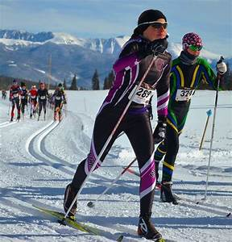
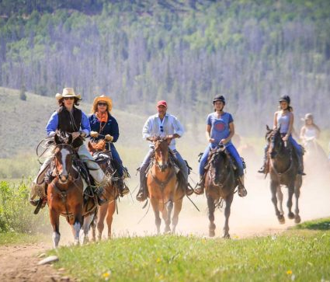
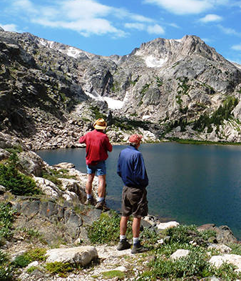
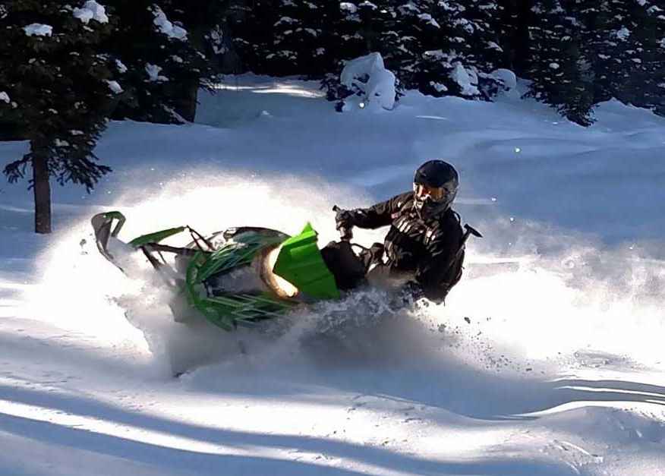
Economic Impacts of Outdoor Recreation
A Study for Grand County and the Headwaters Trail Alliance
Prepared by:
Summit Economics
2021
Principle Authors:
Jason Doedderlein
Tom Binnings
Paul Rochette
© 2017 Summit Economics, LLC

Slide 2
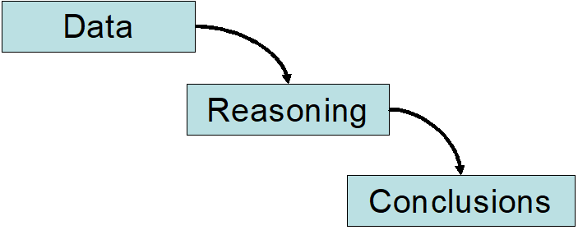
Summit Economics, LLC provides research and consulting services in applied socio-economics, public policy, market research, economic impact analysis, real estate research, urban economics, and strategy development. Our most frequent engagements support decision-making, quantify visioning and planning, develop performance metrics, or assist with risk management.
The firm specializes in empirical research and rigorous analysis to provide objective and quantifiable support for sound decision making.
For more information, please visit www.SummitEconomics.com, or email tom@SummitEconomics.com

Slide 3
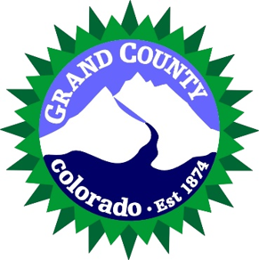
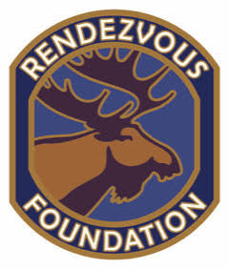
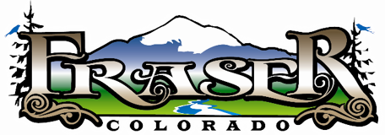
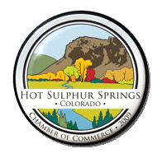
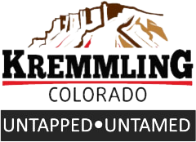
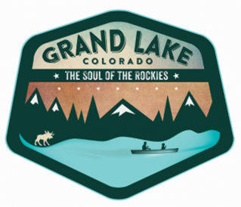
Project Sponsors

Slide 4
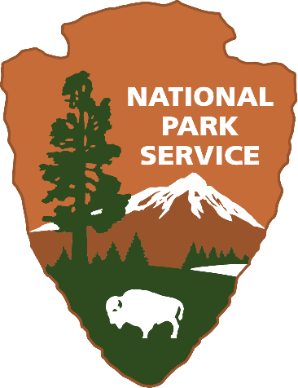
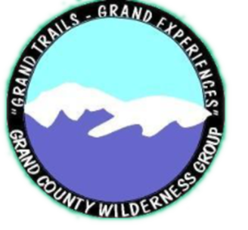
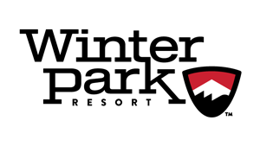
Project Contributors

Slide 5
Table of Contents
Summary ……………………………………………………………………. 6
Study Introduction and Overview ………………………………….... 7
Grand County Overview …………………………………………………. 12
Outdoor Recreation Tourism (ORT) in Grand County ………….. 17
ORT: Economic Impacts ……………………………………………….. 27
Additional Contributions from Outdoor Recreation Assets …. 32
ORT: Fiscal Impacts ……………………………………………………… 37
Future Trends ……………………………………………………………… 42
Lessons From COVID-19 ……………………………………………….. 47
Conclusions & Recommendations …………………………………… 50
Appendices ………………………………………………………………… 54

Slide 6
Project Summary
This study, completed for Grand County and the Headwaters Trails Alliance, was commissioned in order to assess the economic and fiscal impacts of outdoor recreation tourism within Grand County and to review the economic and fiscal impacts, overall, of outdoor recreation assets on the county.
This work built upon previous efforts to better understanding of tourist behavior, spending, and impact undertaken through the Grand Profile. Summit Economics was able to analyze the information collected by the Grand Profile¹, add accurate estimates of visitation and tourist behavior in Grand County, and deepen and augment the conclusions through extensive secondary research.
The key findings include:
- Outdoor recreation tourism accounts for approximately 61% of the Grand County economy
- Overall impacts from outdoor recreation accounts for approximately 78% of the Grand County economy
- These impacts generate 8058 of the county’s jobs
- Spending by outdoor recreation tourists accounts for 73% of the county’s sales tax revenues
- Outdoor tourism sales taxes contributed $1.25M to County’s ‘Open Lands, Rivers, and Trails’ Fund in 2019
- Second homes account for 72% of residential property taxes in the county and most of the construction industry
- Homes closer to outdoor recreational assets show a 58% greater dollar per square foot value
The contribution of the county’s outdoor recreation sector is significantly larger than that of any other industry in the county and continues its historical role of being the main driver behind the economy of Grand County.
1 This critical source of information could not have been used without the cooperation and assistance of Jeremy Kennell

Slide 7
Introduction and Study Overview
Objective and Purposes
Key Questions
Methodology

Slide 8
Research Objective
“Document the size and types of tourism, and the economic and fiscal impacts of outdoor recreation-based tourism on Grand County.”

Slide 9
Purpose of Study
Educate the community on the value of outdoor recreation to tourism, the local economy, and tax base of the County.
Assist with tourism and economic development activities of the public and private sectors.
The ‘Research Objective’ describes the ‘What’. What is it the report intended to articulate or convey?
The study’s ‘Purpose’ outlines the ‘Why.’ Why is this study important? Why is it being undertaken? Why is it necessary?

Slide 10
Key Questions
How many tourists visit Grand County because of the County’s outdoor recreational assets, how long do they stay, what do they do, and how much do they spend?
What are the economic impacts from this tourism in Grand County?
What are the fiscal impacts?
What additional economic and fiscal impacts result from Grand County’s outdoor assets?
What is the total economic impact from these sources?
What percent of household income and economic output in Grand County can be attributed to the County’s outdoor recreational assets?
What is the approximate contribution to the tourism economy from various activities, such as downhill skiing, hiking, snowmobiling, or mountain biking?
What are the key fundamental drivers of the outdoor tourism economy and what trends may influence the drivers in the coming decades?
Are there appropriate and affordable metrics that can be utilized on an ongoing basis to help monitor and plan for the outdoor tourism economy?
What lesson’s can be learned from 2020’s wildfires and COVID-19?
Outlined to the right are the key questions identified in discussions prior to beginning this study.
Answering these questions is fundamental to fulfilling the objective and purposes.

Slide 11
Approach & Methodology
Tourism visitation:
SeeSource, Longwoods, Grand Profile Survey, Outdoor Industry Association (OIA) annual report, Winter Park Resort
Tourism and local engagement in outdoor activities:
Grand Profile Survey
Outdoor Industry Association (OIA) annual report
USFS National Visitor Use Monitoring (NVUM) surveys
Tourist spending
Grand Profile Survey
Outdoor Industry Association (OIA) annual report
Longwoods International
USFS National Visitor Use Monitoring (NVUM) surveys
Economic and Fiscal Impacts
IMPLAN (IMPact Analysis for PLANning) tool
Grand County Finance
* Detailed description of these resources can be found in the Appendices
** Additional resources and studies used and reviewed are listed in the Appendices and Bibliography
Numerous studies and local resources were sought out and used. However, as tends to be the case, several data sources became the foundational sources, while others were used to support and validate our findings.
Summit approaches data through the concept of “triangulation”. This is an approach of trying to obtain the same number from at least three different sources. If the findings are in agreement, we have strong confidence in the numbers. If they are in conflict, we search for the reason why and attempt to reconcile the difference.
It should be noted this study looks at economic impacts, which means money being brought into the county from outside of the county. Therefore, only the spending from those outside of the county visiting for outdoor recreation purposes are included.

Slide 12
Grand County: An Overview

Slide 13
Grand County: A Brief History
Grand County’s modern history started with the first cabin built at Hot Sulphur Springs in 1859. In 1860, William N. Byers, founder of Denver’s Rocky Mountain News, built a resort around the springs .
By 1867 “Judge” Joseph L. Wescott became the first permanent white resident in Grand County, settling at Grand Lake, where he erected several log cabins, the fishing apparently so good that he and a friend caught and sold hundreds of pounds of trout Denver during the summer months.
The mining boom never hit Grand County as other areas of Colorado, though there was a small boom in the late nineteenth century. However, due to diminishing gold, the threat of Ute attacks, and the seasonal nature of tourism, in 1885 the population of Grand County was only 15 people.
Ranching and agriculture grew but were limited by the climate and altitude of Grand County. Despite the challenges, lettuce and hay were major cash crops for the region in the early twentieth century.
A major milestone in Grand County’s development was the arrival of the railroad. The first train reached Hot Sulphur Springs on September 15, 1904, coming over Rollins Pass. Construction of the Moffat Tunnel began in 1923 and the same year, US 40 over Berthoud pass was completed. With the growth of skiing, Winter Park Ski Resort was developed by the City of Denver in the 1930’s as part of Denver’s trans-mountain diversion projects. To this day, it is the largest municipally-owned ski area in America.

Slide 14
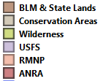
Public Lands
‘Tourism based on… abundant natural assets has proven to be the most consistent industry throughout the history of Grand County.’¹
The majority (approximately 75 percent) of Grand County is public land managed by the US Forest Service, Bureau of Land Management, Colorado Parks and Wildlife, the Colorado State Board of Land Commissioners, and Rocky Mountain National Park.
This public land, the natural beauty of the area, and the County’s proximity to Denver has resulted in a significant level of tourism throughout the County’s history.
Starting with the development around the hot springs and Grand Lake and evolving further with the development of Winter Park Resort, tourism based on the “abundant natural assets”, largely found in the significant public lands, continues to be the driving economic force in Grand County.
¹ https://coloradoencyclopedia.org/article/grand-county.

Slide 15
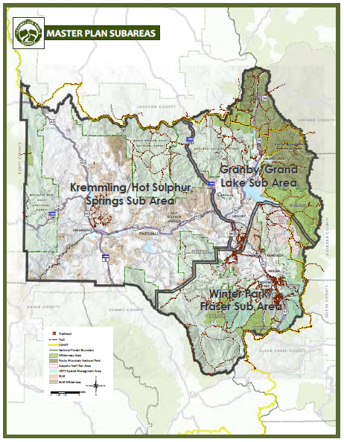
“Land of Many Uses”
As shown in the previous map, there is both an abundance, as well as a variety, of protected outdoor recreational assets in Grand County, each which attracts a different set of users.
National Forest tends to ring the county but is most heavily concentrated in the eastern part of the county. Wilderness area is almost exclusively found in the eastern part, along the continental divide, while BLM and State lands tend to run through the central and western parts of the county.
Given that different assets tend to be prevalent in each area, different activities tend to predominate. Winter Park and the Fraser River valley are known as a skiing and mountain biking destination. Granby/Grand Lake is known, in the summer, as the western gateway to Rocky Mountain National Park and for the lake activities provided by the largest natural body of water in Colorado, and, in the winter, as the snowmobiling capital of Colorado.
The western part of the county, with Kremmling and Hot Sulphur Springs as the predominant towns, the major activity is mechanized trail use, such as snowmobiling, dirt-biking, and OHV use, while the Colorado River provides access to those who want to raft and kayak, from mild rapids along the Pumphouse run to the highest rated commercially rafted whitewater stretch in Colorado, Gore Canyon.

Slide 16
Grand County – Recreation Assets Summary
50,000+ average users on the Fraser River Trail (trail counts from 2016-2018)
4.6million visitors to Rocky Mountain National Park (2019)
1,031 miles of trails
Epic Race Series, hosted by Winter Park Resort. The longest standing and largest mountain bike race series in CO
National Sports Center for the Disabled national headquarters in Winter Park. Trails-based recreation facility near Winter Park Resort and a therapeutic riding program at Snow Mountain Ranch
More Nordic trails and a longer Nordic season than anywhere else in North America
The largest natural body of water in the state of CO (Grand Lake)
The Continental Divide Trail runs from Berthoud Pass through the county and into Rocky Mountain National Park
5 wilderness areas and 1 National Park
2 downhill ski areas. 4 Nordic centers
2 downhill bike parks (Winter Park & Granby Ranch)
One of the most popular backcountry ski areas in the state
Natural hot springs at Hot Sulphur Springs
Backcountry huts – High Lonesome and Broome Huts
6 reservoirs open to water recreation
Headwaters of the Colorado River with one of CO’s premier whitewater destinations in Gore Canyon
Grand Lake and the northeast part of the county as “the snowmobiling capital of Colorado”
Trailridge Road through RMNP is the highest continuous highway in the country

Slide 17
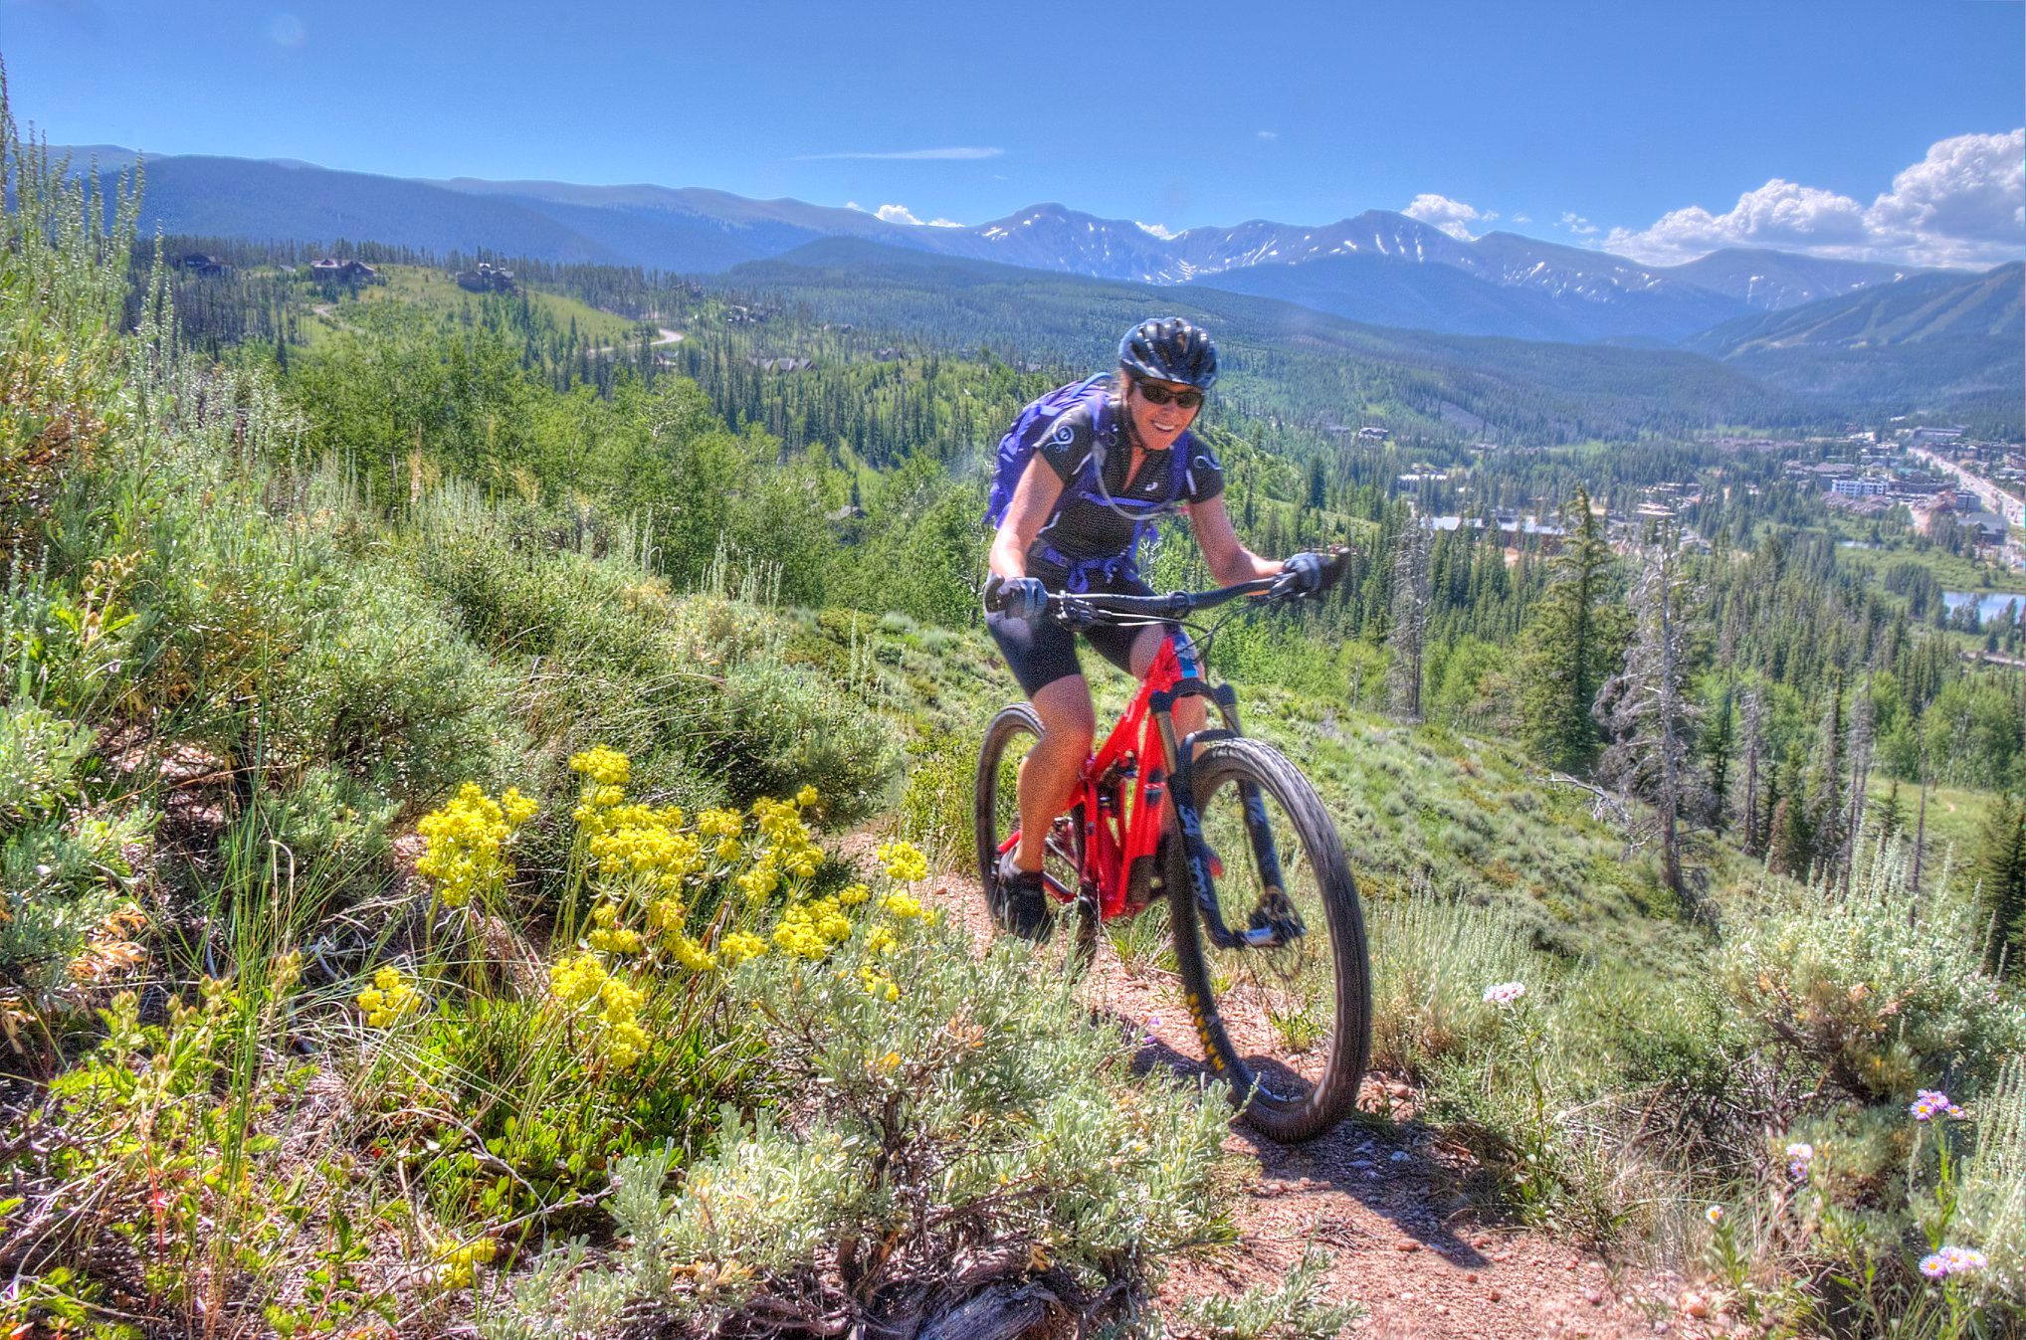
Outdoor Recreation Tourism in Grand County
Bench trail in Rendezvous

Slide 18
Methodology: Grand County Tourism
The approach taken to identify the size and type of tourism used several data sources to obtain and validate findings.
The final tourism numbers were derived from SeeSource, a company contracted by the County to better understand visitation to Grand County using cell phone GPS data.
Any cellphone in the county, that is on, is captured in this data set. Using this data from cellphone users, and knowing the zip code associated with the phone, Summit could accurately estimate the number of people visiting, where they visited, where they were visiting from, and how long they stayed.
SeeSource looked at Grand County as a whole, the six major towns, and geographic regions of specific recreational value.
This information was checked against several other sources including data from Winter Park Resort, CDoT, Longwoods International (a leading tourism intelligence firm), the Outdoor Industry Association, and other research studies providing insight into outdoor tourism behavior.
“Document the size and type of tourism…”
* A detailed description of data and information sources, their limitations, and their uses is outlined in the appendices.

Slide 19
Grand County Tourism (2019)
Grand County Tourism (2019)
Winter (Nov - Apr) |  |  | 880,729
 | Day |  | 504,477
 | Overnight |  | 380,571
Summer (May - Oct) |  |  | 1,120,927
 | Day |  | 571,259
 | Overnight |  | 549,668
Given the unique situation caused by the COVID-19 pandemic, 2019 was the year chosen for analysis, with the assumption that represents ‘normal’ times (though, as we’ll see when we review insights from COVID-19 later, 2020 was a record-breaking year).
According to the data collected, and accounting for visitation of friends and family unrelated to outdoor recreation, we find just over 2 million tourists visit Grand County throughout the year.
Those who stay overnight do so for an average of 3.5 days, meaning Grand County received a total 4.5 million tourist visit-days in 2019 .
Summer visitation accounts for between 56% of annual visitation-days, while day and overnight stays are 51% and 49%, respectively.
Grand County Visit-days (2019)
4,499,496
Summit Economics

Slide 20
Weekly Grand County Visitation (2019)
* SeeSource

Slide 21
Top Grand County Outdoor Recreation Activities
Activity | Total Visit-Days | Percent of Visit-Days
Downhill skiing (resort) | 985,321 | 21.9%
Sightseeing / Wildlife Viewing | 679,472 | 15.1%
Hiking | 642,911 | 14.3%
RMNP | 445,265 | 9.9%
Mountain Biking | 257,699 | 5.7%
Tubing | 218,685 | 4.9%
Fishing/Ice Fishing | 185,269 | 4.1%
Cross country skiing | 170,555 | 3.8%
Camping/Backpacking | 151,887 | 3.4%
Water sports | 128,068 | 2.8%
Road biking | 124,961 | 2.8%
Snowmobiling | 124,638 | 2.8%
Golf | 89,196 | 2.0%
Snowshoeing | 76,904 | 1.7%
Horseback riding | 72,135 | 1.6%
It is important to know how many people are visiting. But equally important, perhaps even more so, is to know what those people are doing. Why are they coming to Grand County and how are they spending their money?
The table to the right shows the top 15 activities participated in, by visit-day (1 person stays and participates in an activity for 2 days, that is 2 total visit-days. If split between two activities, each gets 1 visit-day).
As can be seen from the table, skiing, enjoying the views (sightseeing, wildlife watching, and often RMNP), and trail activities account for the vast majority of what draws tourists to Grand County.
* Grand Profile Survey
** Summit Economics

Slide 22
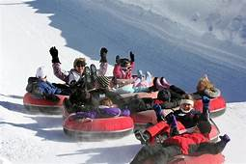
Deeper Analysis: Tubing & Sledding
Tubing & sledding. These activities’ appearance high on the list of tourist activity participation (simply listed as “tubing”) created some surprise, hesitance, and questions initially. This led to additional research to validate or invalidate the findings, including reaching out to the activity locations.
While looking deeper, there was surprise in how significant of a draw tubing is for Grand County. In visitor surveys it is one of the top activities cited as what they found memorable about their winter visit.
Additionally, tubing hills have a quick turnover (can see large numbers even with moderate active use at any one time), is family-oriented (large group size), has a higher percent of overnight stays than most activities, and is spread across at least seven different locations, including Winter Park Resort.
A drive by Colorado Adventure Park on a weekend day will give a good indication of exactly how popular this activity is for visitors to the area. Add Winter Park Resort, Devil’s Thumb Ranch, Snow Mountain Ranch, Hideaway Park, the Grand Lake Touring Center, and the Fraser Tubing Hill, and these add up to an unexpectantly significant economic impact.

Slide 23
Visitor Types
The data used to identify the number of tourists was able to identify the visitor’s average length of stay (‘LOS’). The data from SeeSource contained the number of days a person stayed, up until 6 days. Anyone staying longer than 6 days was grouped in a category of ‘6+.’
Using the Grand Profile, an extensive survey conducted for the County to understand visitor behavior, Summit was able to identify the percentage of visitors who fell into different categories and what the average length of stay was.
This survey included the categories ‘Day Visitors’ and ‘Overnight Visitors,’ which are what we tend to think of when we consider tourists. However, a significant percent of those visiting fell int0 the ‘Second Home/Seasonal’ category. These are individuals who, as the name would indicate, own a second home in Grand County (2/3 of the housing stock in Grand County are second homes) and seasonal visitors, who likely rent a house or condo for an extended period of time.
Each of these visitor types engages in different activities and engages in different spending patterns and looking at each category provides insight into the behaviors of different visitor types. The Grand Profile provided a detailed account of these behaviors and patterns.

Slide 24
Deeper Analysis: Activity by Visitor Type
Activity | Day Trip % | Overnight % | Seasonal / Second Home %
Downhill skiing (at a resort) | 17.2 | 10.4 | 8.3
Hiking | 16.8 | 16.6 | 18.6
Sightseeing | 16.2 | 15.7 | 7.4
Rocky Mountain National Park | 13.2 | 11.1 | 10.6
Mountain Biking | 8.9 | 6.2 | 11.5
Watching wildlife | 8.6 | 10.5 | 10.6
Water sports | 2.6 | 3.5 | 4.1
Camping/Backpacking | 2.6 | 4.4 | 2.3
Tubing | 2.3 | 3.6 | 2.8
Fishing/Ice Fishing | 1.9 | 4.4 | 4.4
Snowshoeing | 1.9 | 1.3 | 3.9
Cross country skiing | 1.9 | 3.2 | 3.5
Road biking | 1.6 | 2.6 | 4.9
Backcountry skiing | 1.3 | 0.6 | 1.7
Snowmobiling | 0.6 | 1.5 | 1.5
Horseback riding | 0.6 | 2.2 | 1.3
Hunting | 0.3 | 0.6 | 0.5
Rock Climbing | 0.3 | 0.5 | 0.5
The table to the right yields some interesting insights into the activities by various visitor types. For example, probably not shocking that second-home and seasonal visitors engage in ‘Sightseeing’ at a lower frequency than day or overnight visitors. However, their lower rate of skiing, while having higher rates of mountain biking and hiking, is interesting and would seem to indicate these are largely summer visitors, with second-home owners possibly renting out their homes during the high value winter season.
Also surprising are insights gleaned from the percentage of activity participants who stay overnight. This is an important distinction because overnight visitors spend more money and have a larger economic impact. One surprise is the low number of people who engage in skiing (downhill and backcountry), snowshoeing, and downhill mountain biking who stay overnight. This is likely because of the proximity of Winter Park and the trails in Grand County to Denver. However, horseback riding and snowmobiling both exceed 70% for participants staying overnight.
* Percentages above obtained through Grand Profile Surveys

Slide 25
Deeper Analysis: Overnight by Activity Type
Activity | Overnight vs Day Trip
Horseback riding | 77.4%
Snowmobiling | 70.5%
Fishing/Ice Fishing | 64.9%
Hunting | 65.3%
Camping/Backpacking | 62.5%
Cross country skiing | 62.2%
Tubing | 61.3%
Road biking | 61.0%
Rock Climbing | 60.7%
Water sports | 57.0%
Watching wildlife | 55.0%
Hiking | 49.6%
Sightseeing | 49.2%
Rocky Mountain National Park | 45.7%
Mountain Biking (combined) | 41.0%
Snowshoeing | 39.5%
Downhill skiing (at a resort) | 37.8%
Backcountry skiing | 32.0%
In addition to various activities different visitor-types engage in, there is a question of which activities attract more overnight visitors.
This is a pertinent question because overnight visitors spend more money per day than do day visitors. They stay for, on average, 3.5 days per visit, tend travel in a larger group size, since they are often families, and reduce traffic per visit-day, due to group size and only entering and exiting the county once per extended stay.
The table to the right shows, for each activity, what percent of participants in the activity, stay overnight versus for the day. As can be seen, there are significant differences with ‘Horseback riding’ and ‘Snowmobiling’ both attracting greater than 70% overnight stays.
For those activities with a high percent of overnight stays, there will generally be a higher total amount spend per visitor than those with lower totals.
* Grand County Profile
** Summit Economics

Slide 26
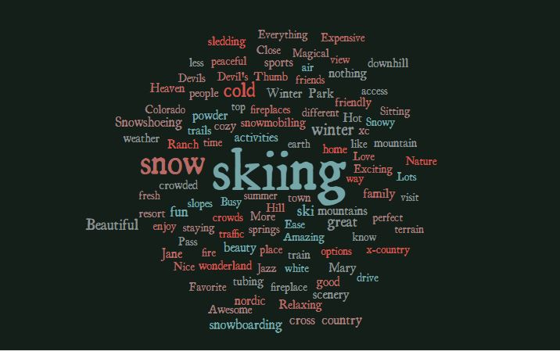
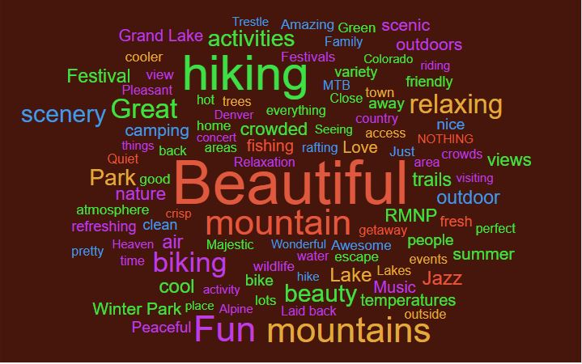
Deeper Analysis: Survey Respondents Statements about Grand County
The Grand Profile asked respondents to make a statement about their impressions of their experience in Grand County. Below is a word cloud associated with each season. Winter is clear: ‘Skiing’ stands starkly out above all else. In the summer, the beauty of the area is what stands out in people’s memories. Hiking is the activity with the largest number of comments.
* Additional word clouds by different user-type for different seasons found in Appendix H

Slide 27
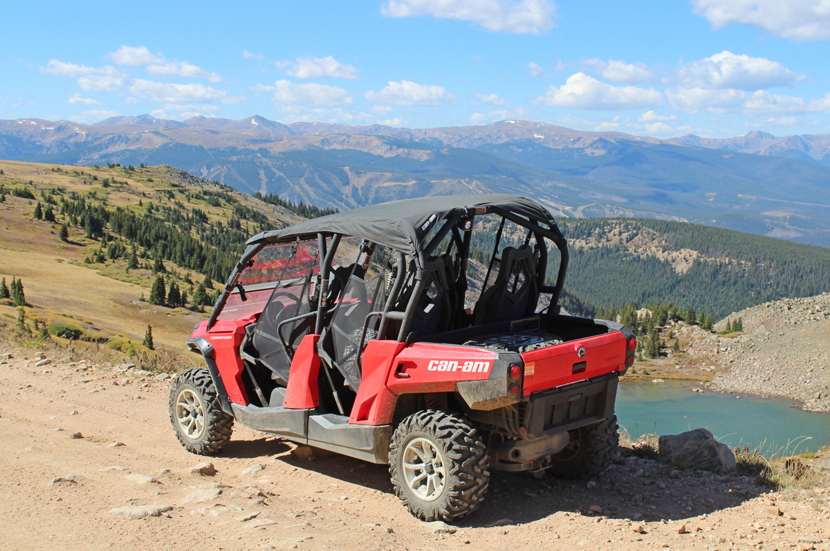
Economic Impacts of Outdoor Recreation in Grand County
ATV at Corona pass

Slide 28
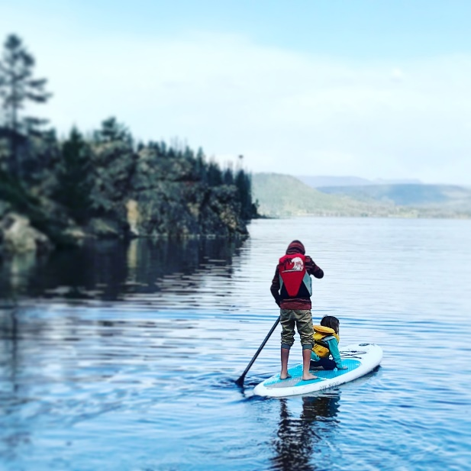
Methodology: Economic Impact Analysis
Obtaining the overall tourism numbers and the outdoor activity participation rates, in the previous step, was a critical step in modeling the economic impacts.
Next, the daily spending, per day per visitor, by day and overnight visitors needed to be acquired. This was done using the Grand Profile Surveys, Longwood International information, and additional studies looking at spending patterns for individual activities. This provided the direct spending amounts by tourists participating in each various outdoor activity.
From direct spending by activity, the industry standard economic impact modeling tool, IMPLAN, was used to estimate overall economic impact by outdoor recreation tourism, as well as by each outdoor activity for which we had data.
“Document … the economic and fiscal impacts of outdoor recreation-based tourism on Grand County.”

Slide 29
Outdoor Recreation Tourism Impacts
 | Visitors | Direct Spending
Day Trip | 1,020,106 | $104,140,964
Overnight | 981.550 | $485,718,816
Total | 2,001,656 | $589,859,780
Overall, it is estimated that the, almost, 2 million outdoor recreation tourists spend over $589 million in Grand County during their visits.
This spending directly creates 4657 jobs, accounting for 43% of the workforce in the county.
However, the impacts resulting from the tourism spending continue beyond the restaurant, hotel, gear supplier, or ski slope where it was spent.
First, there are ‘indirect’ impacts. These result from business-to-business activities, such as a restaurant purchasing beer from a local microbrewery and selling it to a tourist. Not only does the restaurant see the benefit of that spending, so does the brewery.
Additionally, there are ‘induced’ impacts resulting from increased income generated by the direct and indirect effects. Some percent of the increase in income is spent locally, supporting those businesses and the employees who work there.
The indirect and induced impacts are how the direct tourist spending ‘ripple’ throughout the economy. These impacts result in over 1000 additional jobs, $42 million in labor income and contributed an additional $87 million to the county’s gross domestic product.
Overall, 61% of Grand County’s workforce is employed as a result of outdoor recreation tourism.
* Additional job creation will be shown in the following sections.
SeeSource
Summit Economics
Implan Output | Employment | Labor Income | Value Added | Econ Output
Direct | 4657 | $ 128,746,581 | $ 224,906,379 | $ 388,450,285
Indirect | 591 | $ 27,150,444 | $ 51,035,824 | $ 84,289,515
Induced | 446 | $ 15,247,065 | $ 36,761,223 | $ 58,836,487
Total | 5694 | $ 171,144,090 | $ 312,703,426 | $ 531,576,287
IMPLAN
Summit Economics

Slide 30
Top Activities – Economic Impact
Activity | Total Visit-Days | % of Tourism Spending | Total Tourist Direct Spending
Downhill skiing (resort) | 985,321 | 30.4% | 178,965,979
Sightseeing / Wildlife Viewing | 679,472 | 12.7% | 74,941,102
Hiking | 642,911 | 10.9% | 64,088,448
RMNP | 445,265 | 8.1% | 47,986,186
Tubing | 218,685 | 5.3% | 30,945,106
Mountain Biking | 257,699 | 4.7% | 27,800,738
Snowmobiling | 124,638 | 4.1% | 23,942,716
Fishing/Ice Fishing | 185,269 | 3.6% | 21,201,755
Cross-Country Skiing | 170,555 | 3.4% | 19,771,132
Water Sports | 128,068 | 3.2% | 18,901,742
Camping/Backpacking | 151,887 | 2.8% | 16,510,278
Golf | 89,196 | 2.5% | 14,813,682
Road Biking | 124,961 | 2.5% | 14,726,042
Horseback Riding | 72,135 | 1.4% | 8,409,424
Snowshoeing | 76,904 | 1.3% | 7,500,339
Each activity that draws people to Grand County generates an economic impact, which varies by the number of people and the amount of spending by those engaging in the activity. Some activities yield higher spending per person per day than do others.
To the right is a table showing the visitation, the percent of overall spending, by activity, and the total direct spending by all activities accounting for greater than 1% of overall spending.
Grand County Profile
Summit Economics

Slide 31
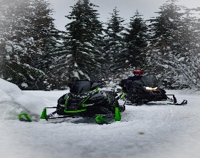
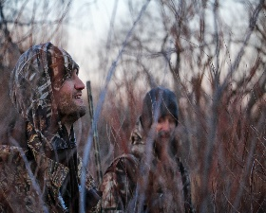
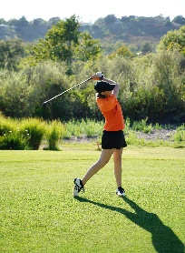
Deeper Analysis… Big Spenders
Activity | Spend Per Day | Spend Per Visit
Snowmobiling | $ 192.10 | $ 544.39
Hunting | $ 190.22 | $ 513.36
Downhill skiing (resort) | $ 181.63 | $ 387.54
Golf | $ 166.08 | $ 351.76
Water sports | $ 147.59 | $ 366.25
Guided Tour | $ 145.03 | $ 411.02
Tubing | $ 141.51 | $ 367.16
Road biking | $ 117.84 | $ 304.85
Horseback riding | $ 116.58 | $ 351.17
Cross country skiing | $ 115.92 | $ 289.08
Fishing/Ice Fishing | $ 114.44 | $ 307.56
Rock Climbing | $ 113.06 | $ 291.73
Sightseeing / Wildlife Viewing | $ 110.29 | $ 248.20
Camping/Backpacking | $ 108.70 | $ 283.06
Skating/Ice Hockey | $ 108.68 | $ 202.14
Mountain Biking | $ 107.88 | $ 222.96
RMNP | $ 107.77 | $ 235.75
Backcountry skiing | $ 105.63 | $ 193.40
Hiking | $ 99.68 | $ 203.54
Snowshoeing | $ 97.53 | $ 197.73
The reason attracting skiers is such a focal point of mountain areas is because of the amount of money skiers spend, particularly those who are overnight visitors. However, there are other activities that also yield high spending for overnight visitors but have a higher percent of visitors who stay overnight than does skiing. This leads to a higher average spending per day per visitor and a higher spending per visitor. Acknowledging skiing as an already known and coveted tourist segment, below are three additional activities that yield the highest amount of spending per day and per visitor.
Snowmobiling: Snowmobilers yield the highest overall spending per day per visitor and the highest spend per visit in Grand County, even higher than skiing. This is due to their high rate of overnight stays. This segment creates a significant impact, particularly in the western part of the county and in the Grand Lake area, which is known as the “snowmobiling capital of Colorado.”
Hunting: Hunting has long played a roll in tourism in Grand County. Though the percent of the population engaging in hunting is decreasing, the hunter is still a desirable tourist segment, as big-game hunting, in particular, tends to draw big spenders. As can be seen in the table to the right, in addition to snowmobiling, hunting is the only activity to generate greater than $500 per visit per individual, on average.
Golf: Along with skiing, golfers have also long been a sought-after tourist segment to attract. Tending to be wealthier participants, golfing yields a high daily spending per person. Along with skiing, and the other activities noted here, golfing is the only other activity generating over $150 per day spending per visitor. Some of the visitors may spend several hundred per day.
Grand County Profile, Longwoods International, additional studies
Summit Economics

Slide 32
Additional Economic Impacts
Though tourism is the most obvious driver of economic impacts from Grand County’s natural assets, additional impacts are created through other sources.
Retirees, who always vacationed in Grand County and dreamed of moving there some day; Location-neutral workers, who can live anywhere but chose Grand County to be close to the slopes or the trails; Commuters, willing to deal with a long drive to have the privilege to start and end each day in the place where they play.
Tourism spending does not account for the impact from these, and more, examples. These are the people drawn to the quality of life that Grand County offers, but that draw their income from outside the area. In this section, we’ll look at the significance of these additional economic impacts resulting from the outdoor recreation assets in Grand County.

Slide 33
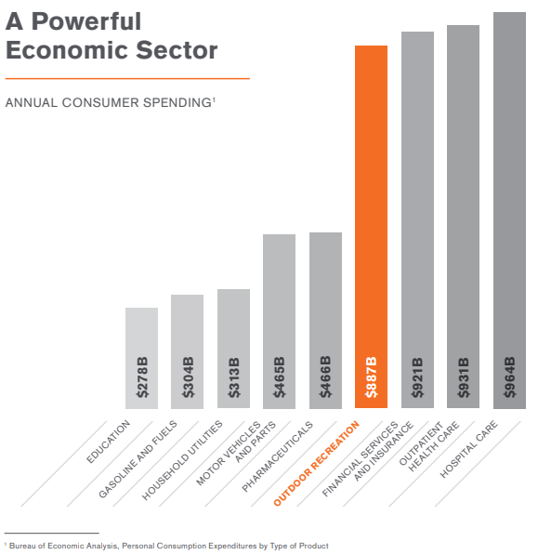
Outdoor Recreation Industry
Data from the Bureau of Economic Analysis shows the significance of the outdoor recreation industry.
Industries we think of as major economic contributors to the US economy often see a fraction of the consumer spending as the outdoor industry.
The jobs created in Colorado by this sector is ‘nearly four times’ that of the oil & gas and mining combined.
The segmented and small-business aspect of outdoor recreation resulting in less lobbying and advertising power than more organized and better funded groups like the automobile or pharmaceutical industries.
Given this reality within the US and Colorado, where does Grand County stand?
Outdoor Industry Association, 2019

Slide 34
Tourism and the Grand County Economy
A report by the Colorado Department of Local Affairs to Grand County showed the tourism industry directly accounted for just over 59% of the County’s base industry (industry that brings outside dollars into the local economy) in 2018.
This number is very much in alignment with the 61% conclusion identified in the economic impact description, using a very different approach, enhancing the confidence in the findings.
Additionally, let’s look at other ways the natural assets in Grand County impact the overall economy. For example, retirees account for 7.5% of the economy. What portion of that is due to retirees moving to Grand County to be closer to the outdoor recreation and natural beauty offered by Grand County? What about the commuters, who account for 2.6% of the economy? How many endure a long drive to Golden, Boulder, or Denver in order to live in Grand County, instead of living closer to work and only heading to the mountains on weekends? There are those whose work allows them to work from anywhere with an internet access, and they chose to work in Grand County because of the recreational opportunities and/or natural beauty of the area.
All of these bring inflows of capital into Grand County and can be, to some degree, attributed to Grand County’s outdoor recreation and natural assets attracting people to the area when they could choose to live elsewhere.

Slide 35
Tourism and the Grand County Economy
Using the same graph from the previous page we focus in on the other sectors of the economy and review them to determine if some percentage of that sector can be accounted for by outdoor recreation.
“Dividends, Interest, and Rent” refers to revenue sources for those found within the County and, as a “Base Industry” involves income coming from outside the county.
“Regional Services” comprise of the basic services a community needs in order to function (more on the next slide).
“Retirees” and “Transfer Payments” involve receiving income from outside of the county, whether though withdrawals on a retirement account, social security, or other sources.
“Commuters” work outside of the county but live and spending their income within the county.
Each of these sectors is in some way contributed to by those who live in Grand County because of the outdoor assets of the area. The question is how much.

Slide 36
Validating Findings
The table seen here uses data from the Colorado State Demography Office, reflecting the same information from the previous chart, but for 2019.
Summit, prior to running the economic impact model outlined in the previous section, used these numbers to make some assumptions to test the output of the model.
Given the assumptions, the percent of the workforce attributed to tourism was identical to the output of the economic impact model, concluding that 61% of the workforce in Grand County is employed because of outdoor recreation tourism.
Using the same methodology, to determine the additional contribution of outdoor recreation, from the sectors outside of tourism, the conclusion was reached that approximately, 78% of Grand County’s economy is dependent upon the county’s outdoor recreation assets.

Slide 37
Fiscal Impacts of Outdoor Recreation in Grand County

Slide 38
Grand County Sales Tax
Of the $5.7M sale tax revenue received by the county in 2019, an estimated $4.2M was as a result of Grand County’s outdoor recreation assets. This accounts for 73.4% of Grand County’s sales tax receipts.
The County collects a sales tax of 1.0% and since 2017 has collected an additional 0.3% for the ‘Open Lands, Rivers, and Trails Fund’.
These taxes have seen an annual growth rate greater than 10%, over the past five years. This greatly exceeds the population growth in the county and appears to be driven by outdoor recreation tourism, including second-home owners.
In 2020, despite COVID-19, this trend has continued, as the county saw a record number of people engaging in outdoor recreation and record sales. This was largely driven by those visiting trail areas, rivers, and reservoirs. These were the areas that quickly saw a rebound after the initial COVID-19 shut-downs, while lodging, resorts, and RMNP continued to lag last years visitation numbers until later in the summer.
Grand County Finance

Slide 39
Grand County Lodging Tax
Grand County Lodging Tax receipts have been increasing, even at a greater rate than sales taxes. Over the past 5 years collections almost doubling in 5 years; a compounded annual growth rate of 15%.
Lodging is almost exclusively driven by tourism in Grand County, and tourism is almost exclusively driven by outdoor recreation.
This, once again, shows how outdoor recreation is driving both the Grand County economy as well as the taxes collected by Grand County.
Grand County Finance

Slide 40
Grand County Property Tax
The housing market in Grand County is strong with a 20% increase in assessed value for 2019 above the previous assessment year (2017).
As pointed out by the 2020 Grand County Budget Report, “The construction industry provides revenue to the County at every step… with building permit revenue through August 2019 up 22% from 2018. Total valuation of projects is up 66% for 2019.”
With 72% of residential property value belongs to second-home owners, 78% of the economy is tied to outdoor recreation assets, and the finding that homes close to wooded recreational assets are valued at $214/sf, 58% higher than those further from such assets, we see the impact of outdoor recreation assets on the property tax collection in Grand County.

Slide 41
Deeper Analysis: 2020 Grand County Annual Budget
A look at Grand County’s $48.6M 2020 budget provides some insight into where the county revenues originate. The bulk of the revenues in the county come from taxes and ‘Intergovernmental’ transfers These transfers, typically grants and other sources of money from the state and federal government, account for 32% of the budget and are generally independent from outdoor recreation in the county. However, reviewing the remainder of the budget, we can see the significant impact outdoor recreation has on the county’s revenues; ‘Property Tax’, ‘Sales & Lodging tax’, and ‘Charges for Services’.
Property taxes account for 25% of the budget ($12M). Property values are increasing quickly with assessed value increasing approximately 20% from the previous valuation(2017. Colorado assesses value every two years). Mining accounts for 6.3% of the budgeted property taxes. Given that, the question is, ‘what percent of property tax receipts can be attributed to outdoor recreation?’
As pointed out in the last slide, second homes alone account for 75% of assessed residential value. Given that approximately 78% of the economy is a result of outdoor recreational assets, it is safe to assume most of the commercial property tax receipts can be tied to the outdoor recreation opportunities within the county.
As the budget report points out, “The construction industry provides revenue to the County at every step… with building permit revenue through August 2019 up 22% from 2018. Total valuation of projects is up 66% for 2019”. This growth and development is largely centered within the Fraser Valley, driven by second homes and outdoor recreation.
The budget includes $1.3 million for lodging tax, which is almost exclusively driven by outdoor recreation tourism.
Lastly, retail sales and recreation spending have increased about 15% from 2018 to 2019. Sales tax is $7.2M, in the budget. We know that sales tax in Grand County is largely driven by tourism, and tourism by outdoor recreation. Once again, with 78% of the economy existing as a result of outdoor recreational assets in Grand County, we can make the general assumption that an approximately equal percentage can be attributed to the sales taxes collected by the County.
Overall, it seems safe to say that over 75% of taxes collected by the county, other than intergovernmental transfers, result from outdoor recreation within the county.

Slide 42
The Future of Outdoor Recreation In Grand County
The previous sections have provided an overview of tourism and outdoor recreation in Grand County, as it stands today.
In this section we’ll look at factors that will influence the future of outdoor recreation in Grand County, including climate change, demographic changes, and participation trends in outdoor recreation.

Slide 43
Trail Use in Grand County
Below is a table outlining the number of people signing in at various trailheads in Grand County. Though used only for Wilderness areas and though not everyone choses to sign in, this record provides a good indication of trail use growth in the County.
As can be seen, average trailhead use more than doubled between the turn of the century and 2018. This is an average annual compound growth rate of 4.1%; 2.5 times the population growth rate in Grand County, 3.5 times that of Colorado, and 7 times that in the US.
Though the growth has not been equally distributed, with Monarch seeing the bulk of increased use, this does show the overall demand for trails and trail access is growing in Grand County.
Trailhead | 2000 | 2001 | 2002 | 2003 | 2004 | 2005 | 2006 | 2007 | 2008 | 2009 | 2010 | 2011 | 2012 | 2013 | 2014 | 2015 | 2016 | 2017 | 2018 | 2019
Monarch | 7,550 | 7,350 | 8,300 | 7,866 | 9,300 | 8,167 | 9,760 | 12,018 | 13,780 | 6,474 | 3,496 | 14,250 | 17,733 | 18,697 | 19,661 | 19,880 | 22,165 | 25,064 | 27,373 | 26,242
Junco | 2,400 | 2,800 | 3,700 | 2,828 | 2,800 | 3,122 | 2,592 | 3,242 | 3,275 | 3,070 | 3,323 | 3,246 | 3,329 | 2,223 | 3,266 | 3,688 | 3,530 | 4,537 | 4,575 | 2,472
Byers Peak | 2,950 | 2,350 | 2,750 | 2,128 | 2,300 | 950 | 977 | 1,003 | 659 | 810 | 901 | 750 | 937 | 994 | 1,000 | 986 | 1,066 | 1,526 | 457 | 859
St. Louis Cr | 2,052 | 2,351 | 2,650 | 2,052 | 2,020 | 1,001 | 853 | 682 | 886 | 754 | 1,112 | 623 | 698 | 604 | 623 | 669 | 764 | 743 | 312 | 784
Baker | 1,230 | 1,530 | 1,150 | 1,144 | 998 | 34 | 1,185 | 991 | 962 | 1,252 | 407 | 890 | 839 | 1,389 | 1,083 | 1,678 | 1,610 | 1,441 | 1,862 | 1,052
Bowen | 830 | 990 | 630 | 616 | 710 | 687 | 628 | 568 | 582 | 651 | 596 | 470 | 612 | 420 | 394 | 796 | 665 | 763 | 817 | 684
Kinney Cr | 270 | 370 | 280 | 252 | 203 | 205 | 131 | 57 | 193 | 328 | 328 | 328 | 328 | 328 | 171 | 203 | 234 | 490 | 458 | 426
Lake Evelyn | 150 | 530 | 520 | 332 | 420 | 430 | 431 | 473 | 351 | 412 | 378 | 344 | 378 | 167 | 410 | 492 | 561 | 517 | 360 | 202
Vasquez | 530 | 615 | 675 | 424 | 530 | 448 | 366 | 400 | 435 | 524 | 461 | 444 | 450 | 455 | 654 | 921 | 817 | 911 | 751 | 720
Totals | 17,962 | 18,886 | 20,655 | 17,642 | 19,281 | 15,044 | 16,922 | 19,434 | 21,123 | 14,275 | 11,002 | 21,345 | 25,303 | 25,277 | 27,262 | 29,313 | 31,412 | 35,992 | 36,965 | 33,441
Avg per TH | 1,996 | 2,098 | 2,295 | 1,960 | 2,142 | 1,672 | 1,880 | 2,159 | 2,347 | 1,586 | 1,222 | 2,372 | 2,811 | 2,809 | 3,029 | 3,257 | 3,490 | 3,999 | 4,107 | 3,716
* US Forestry Service
** Some TH years missing due to closures or other issues. In that case statistical methods were used to fill in missing year

Slide 44
Grand County Growth
Grand County Lodging Taxes
This graph, seen earlier, shows the lodging tax collections between 2015 and 2019, almost doubling, with a compound annual growth rate of 14.7%.
Growth in lodging visits can be used as a good proxy for growth in tourism, as can retail sales.
Combined with the 15% growth in retail sales and recreational spending along with sales tax, and 22% growth in building permits, we see additional evidence of strong continued growth in Grand County, driven by outdoor recreation assets.
As with trail use, the growth rate is significantly exceeding growth in the county’s population. Indications and trends would project this growth to continue for the foreseeable future.

Slide 45
Demographic and Recreation Trends
Demographic Trends:
Grand County has grown rapidly since the 1970s, with 378% growth in the past 50 years. This has outpaced the population growth in the US, at 162% over the same period, and even Colorado, at 261%. The expected continued growth of the US and Colorado, will likely lead to increased tourist demands for Grand County in the future.
As more baby boomers retire and can live wherever they chose, as more people have the freedom to work remotely, and as access to outdoor recreation continues to grow as a priority for much of the population, Grand County should see growth in these areas as well
Recreation Trends:
71% of Coloradans engage in outdoor activities (50% of Americans).
Between 2012 and 2017, total days engaged in outdoor recreation is up 25%, led primarily by trail-based activities (hiking, mountain biking, trail running, snowshoeing, etc.).
Given the trail network and natural beauty of the area, Grand County seems well positioned to take advantage of this trend.
* Additional information, data, and analysis is found in Appendix G

Slide 46
Climate Change
What impact will climate change have on Grand County outdoor recreation assets?
The Bad
Slight precipitation increase in winter, but more will fall as rain decreasing snow quality.
Mid-season snowpack unchanged prior to 2050. Decreasing April-1 snowpack (already being seen)
Earlier and greater peak stream flows, lower average and minimum flows, higher water temperature affecting fish life.
Studies consistently indicate that by the mid-century, the fire season will be longer, the annual area burned will be much greater, and the risk of very large wildfires will be much higher. The summer and fall of 2020 may be indicators of challenges to be faced for Colorado and Grand County in the future.
Opportunities
Longer summer and shoulder seasons
Attracting front range and other residents to cooler climate during hot summers
Milder winters make Grand County more attractive for year-round residence
* More detailed climate change information, forecasts, and analysis found in Appendix F

Slide 47
Deeper analysis:
Lessons from COVID-19

Slide 48
COVID-19 and Community Movement
The graph to the right presents data from Google showing the changes in people’s movements during the pandemic, compared to the previous year.
Though not specific to Grand County, the trend is clear as every location saw a sustained decrease, with the exception of “Parks” and “Residential”.
Using SeeSource data to track the number of people visiting, it was clear that Grand County saw the same effect. The year-over-year change of different areas of Grand County’s visitation is shown on the following page.
Parks

Slide 49
Trails and Water Lead Recovery
Mirroring the national trends observed in the previous slide, Grand County also saw a precipitous drop in visitation during the early days of COVID-19. However, by April, the county had already seen an increase in visitation to its outdoor recreation assets. This drove an uptick in sales taxes even when hotels and ranches and overall Grand County visitation was still down.
Despite the decrease in visitation seen in February and March, and the continued lag in lodging, by June, county collections of sales taxes were already 10% higher, year-to-date, than the previous year, led by trails and water activities, as these were the only two areas to see growth prior to June.

Slide 50
Conclusions & Recommendations
Hikers on the way to Broome hut

Slide 51
Conclusions
Grand County’s outdoor beauty and recreation assets have been the major driver behind the county’s growth and economy since it was first settled. This study concludes that Grand County’s outdoor recreation continues to account for the vast majority of the economy in Grand County.
This study concludes:
Outdoor recreation tourism accounts for approximately 61% of the Grand County economy
Overall impacts from outdoor recreation accounts for approximately 78% of the Grand County economy
These impacts generate over 8,058 of the county’s 10,296 jobs in 2019
Sales from outdoor recreation tourists account for 73% of the sales taxes collected by the county
Outdoor tourism sales taxes contributed $1.25M to County’s ‘Open Lands, Rivers, and Trails’ Fund in 2019
Second homes account for 75% of residential property value in the county
Homes closer to outdoor recreational assets being showing a 58% greater dollar per square foot value

Slide 52
Recommendations
Any asset of value will see a loss of that value without sufficient efforts to maintain it. The degradation of outdoor recreation asset value tends to arise from three threats:
Overcrowding
Overuse / insufficient maintenance
Natural causes, such as beetle kill or wildfires
These threats need to be addressed in order to maintain, or enhance, the value and revenue derived from the outdoor recreation assets (more on methods to address threats to recreation asset value in Appendix E). As an international outdoor recreation destination, those within and visiting Colorado have an abundance of options. Proximity to Denver, a competitive advantage, is unlikely to be sufficient if recreation assets are deemed sub-optimal compared to other nearby options.
Increases in population and tourism, an increase in interest in outdoor recreation, and an increase in participation frequency by those who are active outdoors increase the threats.
Given the contribution of the county’s outdoor recreation sector economically and fiscally, compared to other industry sectors, it is necessary that the assets supporting the recreation sector receive the funding necessary to maintain, or improve, their value or the overuse and/or lack of investment can result in a degradation of the value of that asset and a reduction in the benefits gained.

Slide 53
Final Thoughts
Better data always leads to better conclusions and better understanding. Suggestions for the County to maintain better data for future studies and knowledge of local tourism include:
Regular surveys of locals and visitors regarding visitation, spending, and activities (continuation of the work started by the Grand Profile).
A centralized repository, and managing body, for outdoor recreation industry businesses to maintain data pertinent to their industry.
Maintaining a regular count of the number of out-of-area visitors

Slide 54
For more information, please visit www.SummitEconomics.com, or email tom@SummitEconomics.com

